Slide 1
Introduction / Thinking Like a Computer
Day One of Programming Workshop
Andie Creel (she/her)
January 2025
TF: Eliana Stone

Slide 2

My background
Freshman in college: financial engineering (whatever that is) -> Java
“I am a magician”
Majored in Econ, minored in CS
TAed programming labs in college
Pandemic Hobby: big data
Master’s thesis: Parks use in pandemic (Cell Phone Data)
Dissertation work: Environmental Econ -- value of local recreation and urban green space

Slide 3

My motivation for knowing how to program
Sustainable development: "meets the needs of the present without compromising the ability of future generations to meet their own needs” -- Brundtland Report, 1987
Needs: consumption of goods, health, political stability, culture
The environment affects this
That effect can be hard to observe/measure
Explosion of data and computing power can help us observe and understand how nature affects sustainable development
“What gets measured gets managed” – Peter Drucker (maybe?)
Notes:
Brundtland report is when the world realized GDP wasn’t a good indicator of progresses and welfare when used on its own
Peter drucker is a management consultant

Slide 4
Eliana’s background
Majored in Environmental Studies and Economics
Didn’t start coding till junior year of college
Felt a huge barrier to entry compared to peers with programming backgrounds
Started with classes in R
Now other languages like Python and Google Earth Engine JavaScript are easy to self-learn with online resources
Master’s thesis: Agribusiness lobbying on Brazilian economy and public health (remotely-sensed crop data, decades of municipal election data)

Slide 5
Introductions
Name (pronouns)
What you do at YSE
Why you decided to take this workshop

Slide 6
Goal of next three days
Rid the intimidation factor
Build a foundation for other classes and opportunities to build on
Accelerate the initial learning curve
I tried to build what I wish I had
Advice: Ask questions
Believe that you’re entitled to learn everything the next three days has to offer
Even when you don’t know how to say it

Slide 7
Logistics
9:00 am to 12:30 every morning
Two 60 to 90-minute lectures per day
30 min break between
Lunch!
A mini problem set every day
Not graded, but Eliana will provide some feedback
I will release an answer key at 8pm
Office hours
Location: Sage 8A
Time: 2 – 5 pm
Come to OH (even if you don’t know how to ask your question)!

Slide 8
Outline of Material
Today
Thinking Like a Computer (pseudo code)
Base R
Tomorrow – tidyverse packages
Data manipulation (dplyr, tidyr)
Data Management and visualization (ggplot2)
Friday
Collaboration and Version Control (GitHub)
Programming is Programming (python)
Notes:
- Go look at the github
- canvas for problem sets
- canvas has a discussion boars

Slide 9
Thinking Like A Computer
Skills to help you outline and (eventually) debug code
Thanks to Ethan Addicott and Matt Gordon for early iterations of this lecture

Slide 10
What is programming
Bits and bytes – what the computer actually speaks (0s and 1s)
Machine and Assembly languages -- translates our code to 0s and 1s
Code – R, Python, etc.
Software – Windows, iOS, Applications, Excel, R Studio

Slide 11
What is programming
Bits and bytes – what the computer actually speaks (0s and 1s)
Machine and Assembly languages -- translates our code to 0s and 1s
Code – R, Python, etc.
Software – Windows, iOS, Applications, Excel, R Studio

Slide 12
Some definitions
Code: What your computer runs (different languages)
Script: The text file where you write your code
Comments: Notes you write yourself that the computer doesn’t read
Run (aka compile and execute): when the computer executes your code
IDE/GUI/Software
Where you write and run your scripts and comments
R Studio, Jupyter Notebooks, Google Collab (Collaboratory)
Notes:
IDE: integrated development environment

Slide 13
Why should you think like a computer?
Clear definition of “problems”
Cannot solve a problem that isn’t defined (how do you know it's solved?)
Forces precision and accuracy in problem definition
Collaboration: Once clear to you, can also be clear to team members
Solutions to “problems”
Our field is filled with giant problems
To make progress, need to break them into solvable pieces
Learning to program is learning how to break big problems down
Steps are clear
Notes:
Lets back out
Why is it important to think like a computer (more than coding)
Clear definition of “problems”
Cannot solve a problem that isn’t defined (how do you know its solved?)
Coding forces precision and accuracy in problem definition
Collaboration: Once clear to you, can also be clear to team members
Solutions to “problems”
Our field is filled with giant problems
To make progress, need to break them into solvable pieces
Learning to program is learning how to break big problems down
Steps are clear

Slide 14
Why should you learn to code?
Efficiency and Speed: it’s so much faster
Accurate: not reliant on copy-paste/find-replace
Replicability: teams, peer review, new datasets
Customize: write models for your data, clean and manipulate data for your models
Employment: more jobs, better jobs, more money
Collaboration: compared to Excel, GitHub on our last day
Notes:
Now lets zoom in, why is it worth learning how to code?
Efficiency and Speed – its so much faster
Accurate – not reliant on copy-paste/find-replace
Replicability – for your teams, others, new datasets
Customize – write models for your data, clean and manipulate data for your models
Employment – more jobs, better jobs, more money -- Varies wildly, but on average, people who code make 20-30% more which is something like 10-20k more per year
Collaboration – compared to excel, GitHub on last day

Slide 15
Pseudo Code – first step of coding
What
Pseudo code is the outline of your code
Similar to the writing process
Not a coding language
I do it on scrap paper or in comments at the top of my scripts
Why
Clarify your logic
Serves as road map and plan
Super important for multiple work sessions
Collaboration/Documentation
Can communicate what you’ve done/are doing to others
Notes:
Why
Clarify your logic – are you solving the problem?
Serves as road map and plan – important for multiple work sessions
Collaboration/Documentation – can communicate what you did to others

Slide 16
Exercise One: Coffee
Write instructions for how to brew a cup of coffee (3 min)

Slide 17
Exercise One: Coffee
Switch instructions with a partner
Have them “run” your code
Do you find any bugs? (5 min)

Slide 18
Exercise Two: Rock Paper Scissors
Write instructions for how to play Rock, Paper, Scissors
You will need multiple cases
(5 min)

Slide 19
Exercise Two: Rock Paper Scissors
Switch with a partner.
Play by the rules they just gave you.
Can you cheat??
(5 min)

Slide 20
My pseudo code (lazy)
Player: choose rock paper scissor
Computer: random generate rock paper scissor
Compare P & C
If P = Rock
And C = Rock: tie
And C = paper: player loses
And C = scissors: player wins
Same for if P = paper and P = Scissors

Slide 21
Not Lazy Pseudo Code
While play_again is true
Prompt the player to select Rock, Paper, or Scissors
Generate a random choice for the computer (Rock, Paper, or Scissors)
If player's choice is the same as computer's choice
Display "It's a tie!"
Else If player chooses Rock and computer chooses Scissors
Display "Player wins! Rock crushes Scissors."
Else If player chooses Paper and computer chooses Rock
Display "Player wins! Paper covers Rock."
Else If player chooses Scissors and computer chooses Paper
Display "Player wins! Scissors cut Paper."
Else
Display "Computer wins!"
Ask the player if they want to play again
set play_again to true or false
Notes:
This if else is very elegant because it considers how the player can win, then puts everything else in another case

Slide 22
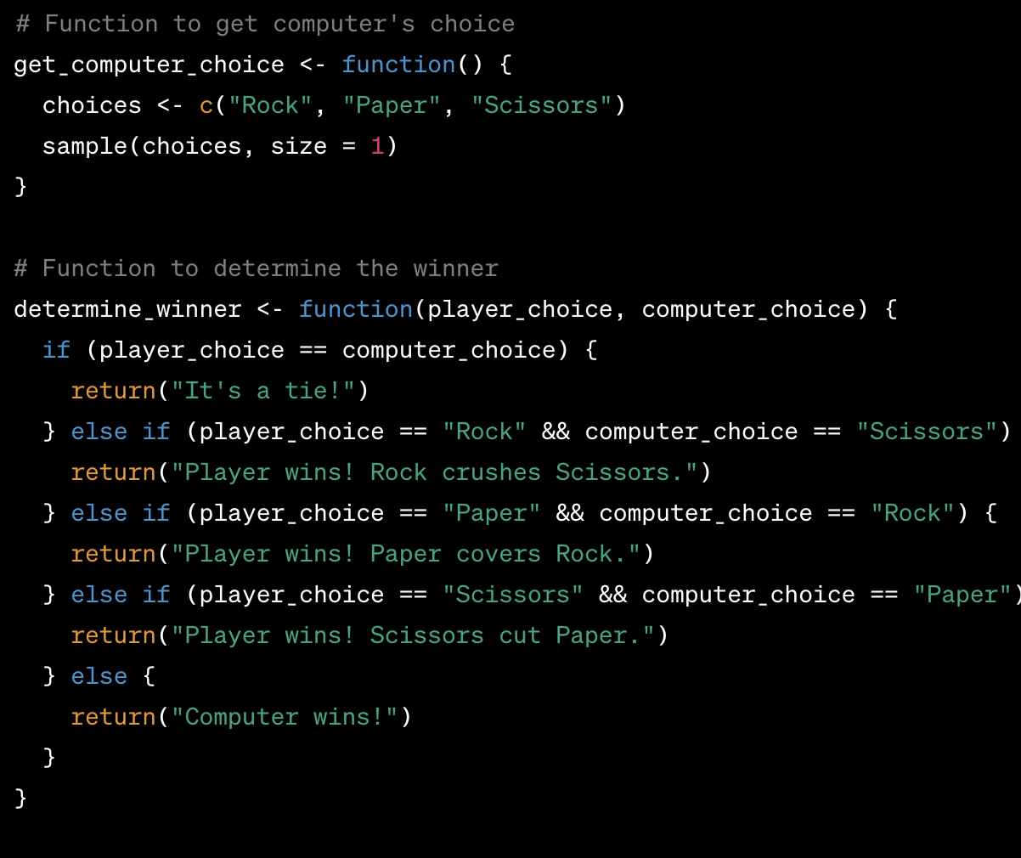
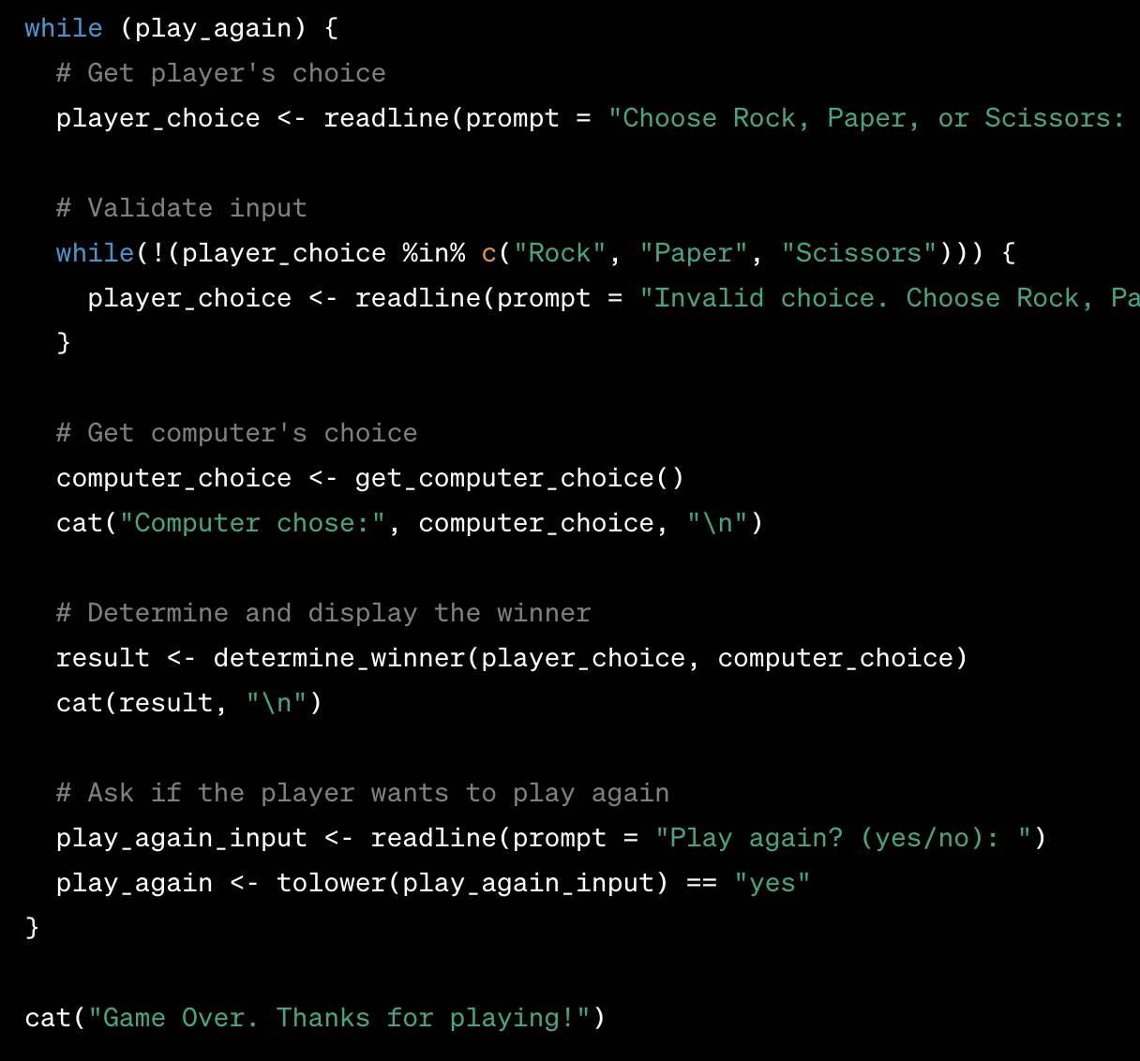
R Code
Notes:
If i told you the C choice and person choice, you should be tell what happens here
Things to highlight in this
Function
If_case cases
Boolean comparison
Loop
Storing a result

Slide 23
Couple of notes on writing, debugging code
“I minored in stack overflow”
I still have to look things up constantly
Knowing programming makes me better at:
Defining problems
Developing solution strategies
Solving harder and harder problems
Documentation, Google, Stack Overflow, and ChatGPT can help you from there
But if you don’t know how to define and solve problems, you won’t be able to take full advantage of these aids
Notes:
Youll see me constantly googling, looking up documentation and asking chat gpt questions
But to actually get anywhere, I need to be able to define the problem and a solution strategy
Like I said at beginning, knowing the basics of programming will help you know how to create solution strategy bc youll have practiced

Slide 24
Couple of notes on writing, debugging code
“I minored in stack overflow”
I still have to look things up constantly
Knowing programming makes me better at:
Defining problems
Developing solution strategies
Solving harder and harder problems
Documentation, Google, Stack Overflow, and ChatGPT can help you from there
But if you don’t know how to define and solve problems, you won’t be able to take full advantage of these aids
Notes:
Youll see me constantly googling, looking up documentation and asking chat gpt questions
But to actually get anywhere, I need to be able to define the problem and a solution strategy
Like I said at beginning, knowing the basics of programming will help you know how to create solution strategy bc youll have practiced

Slide 25
ChatGPT and other AI tools
Any of them could probably solve all of what we do in this class
But they can’t solve everything you’ll eventually want to do
You can’t get to the cutting-edge problems without basics
At the very least, you’ll be limited
Learn basics so that you can get to hard problems, and use AI as a collaborative aid once there

Slide 26

What’s next
30 min break
Base R

